Slide 1
Deep Learning Project
Harold Gamarro
Joe Brian Malubay
Said Mejia
Juan Pablo Montoya

Slide 2
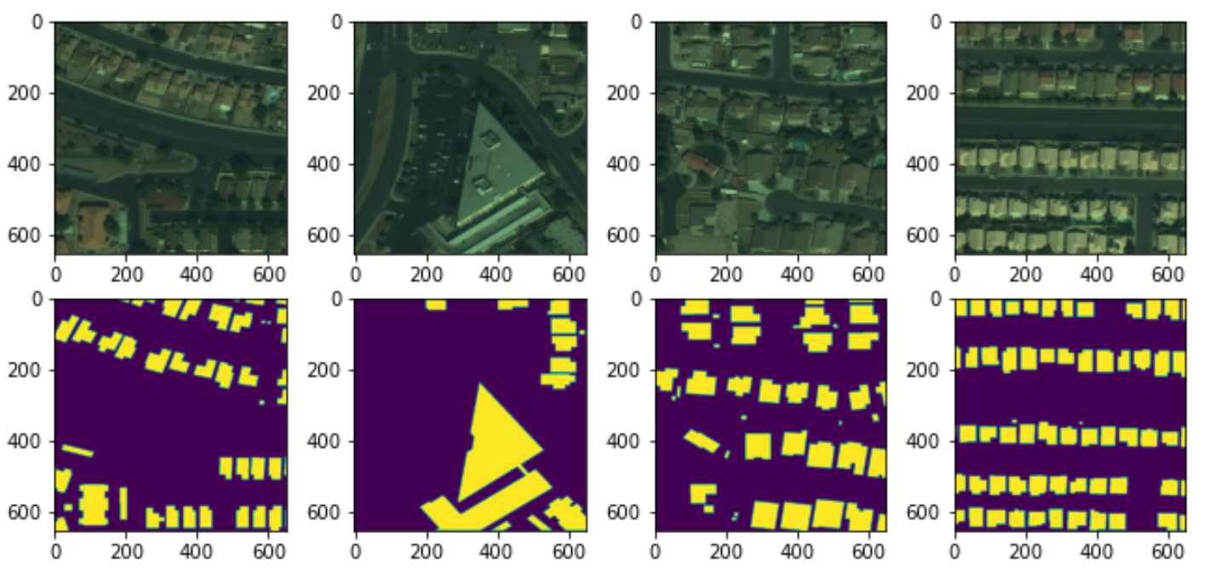
Spacenet Data processing for building detection
Input Image: 3 band geotiff
Input mask: Geojson
Created source code to convert images to jpegs for model input

Slide 3
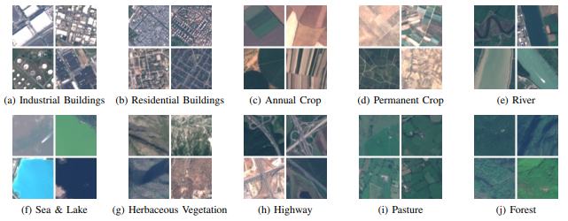
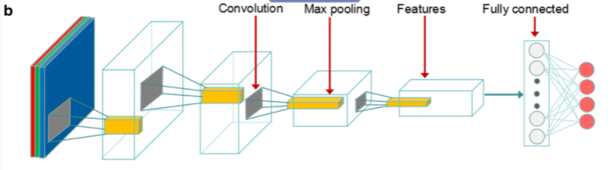
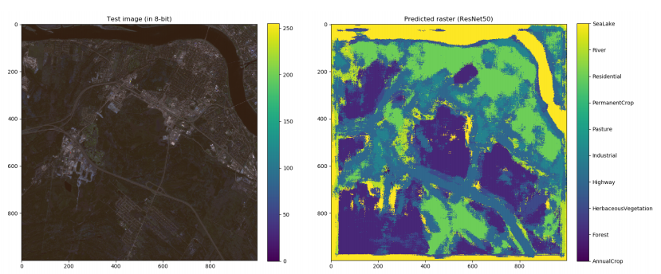
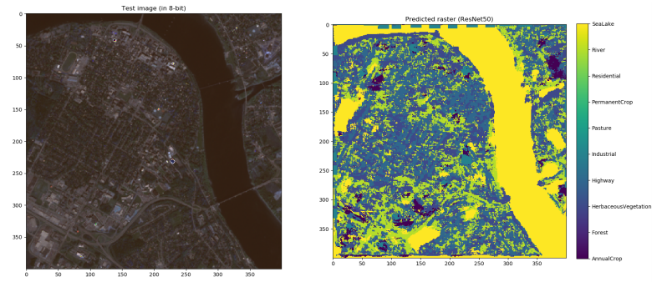
First Approach
It uses REsNet50 and they test it using an experimental image
REsNet50 architecture
Source: EuroSAT: A Novel Dataset and Deep Learning Benchmark for Land Use and Land Cover Classification
Source: LandUse / LandCover Classification using ResNet50

Slide 4
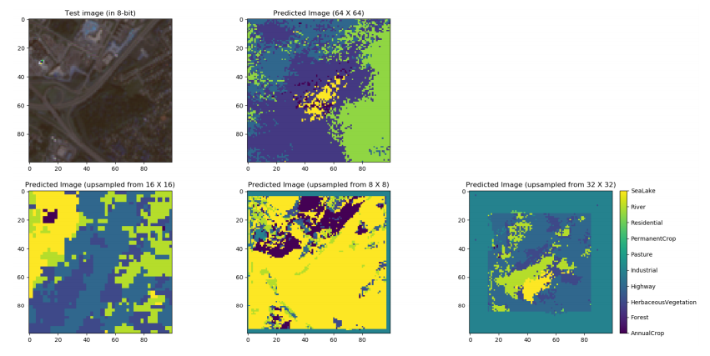
Problems

Slide 5
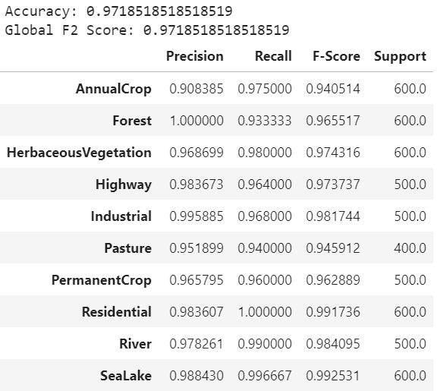
ResNet50 Results

Slide 6
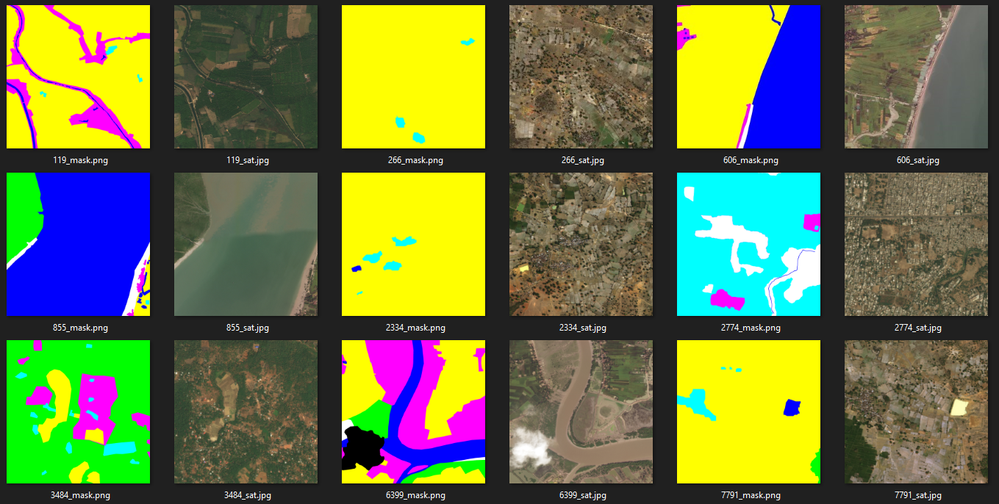
2nd Dataset

Slide 7
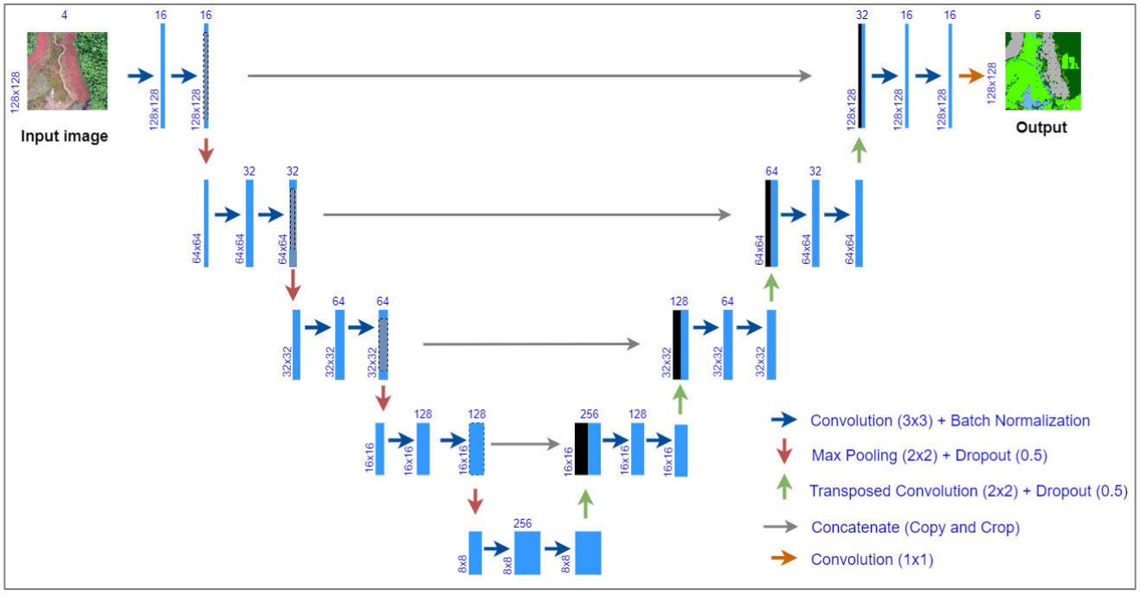
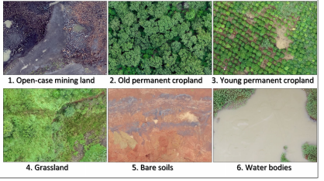
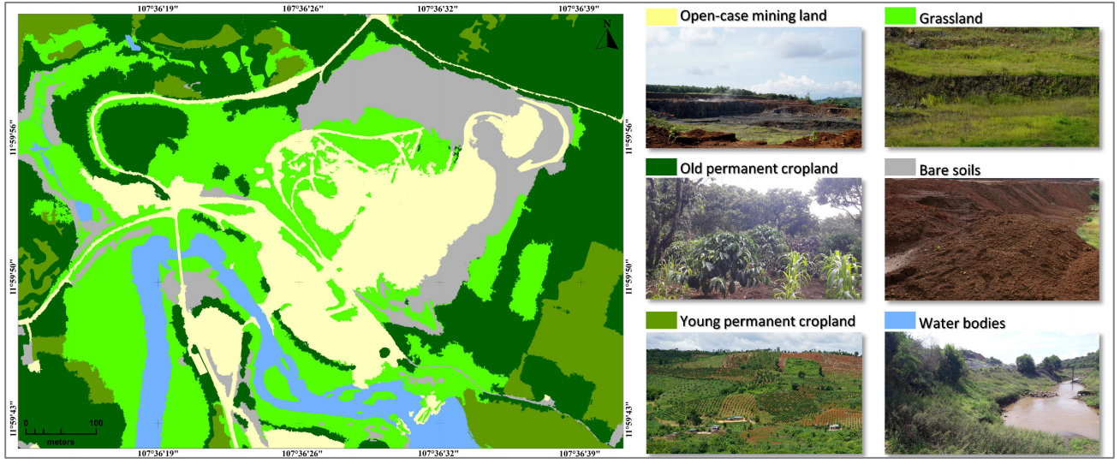
Second Approach U-Net
Image shape: 128x128x4
Source: U-Net Convolutional Networks for Mining Land Cover Classification Based on High-Resolution UAV Imagery

Slide 8
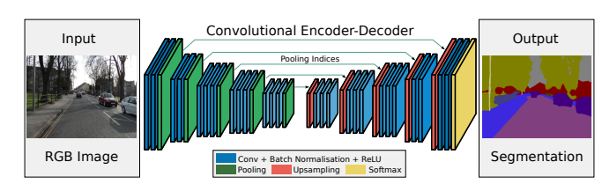
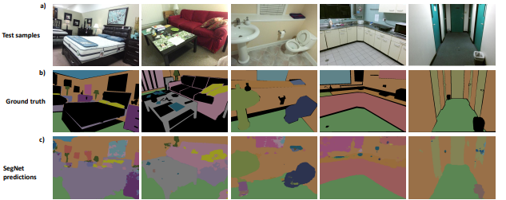
Third Approach SegNet
Source: SegNet: A Deep Convolutional Encoder-Decoder Architecture for Image Segmentation

Slide 9
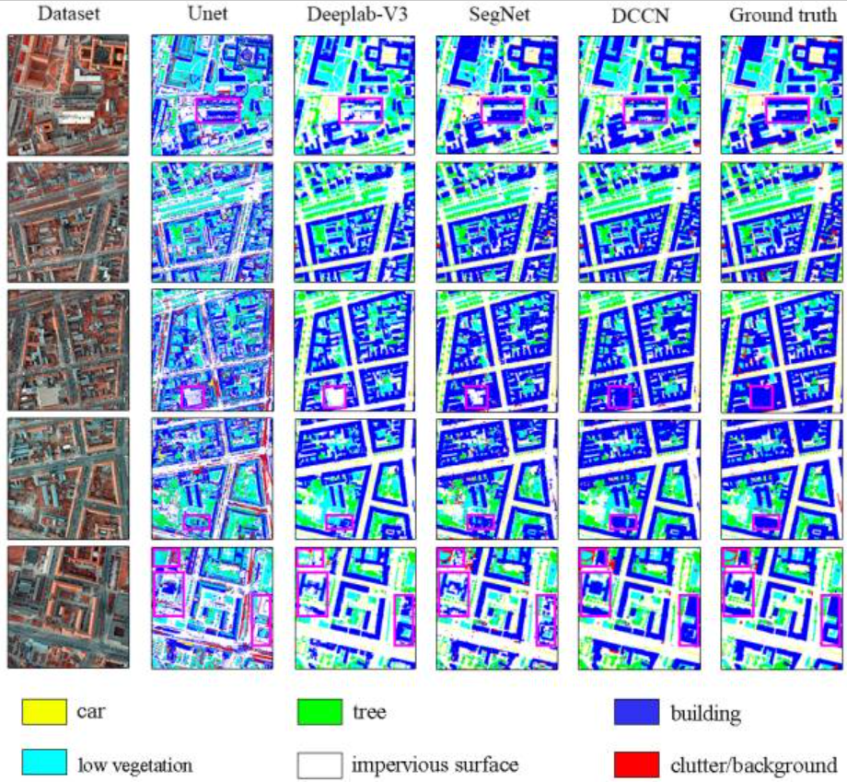
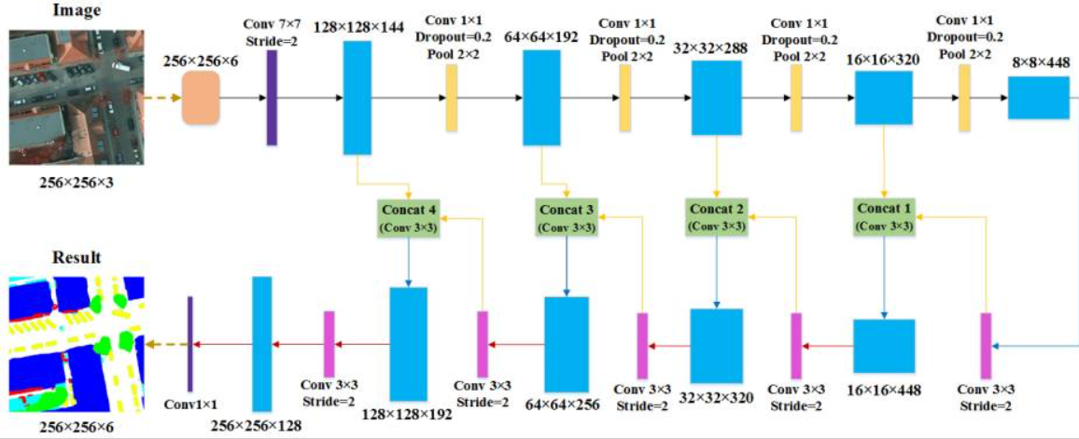
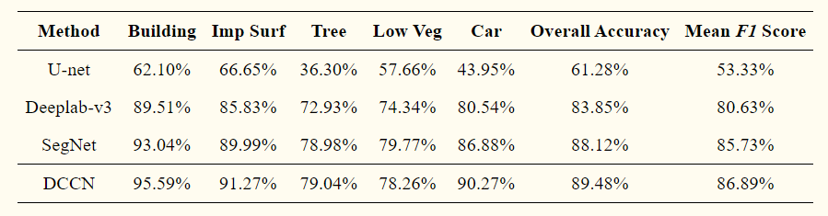
Source: https://www.ncbi.nlm.nih.gov/pmc/articles/PMC6631649/

Slide 10
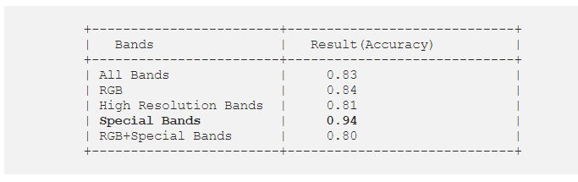
Comments
Develop the each of the 3 approaches
Use second approach using the first dataset from EuroSAT with 12 bands and make some modifications to the number of layers

Slide 11
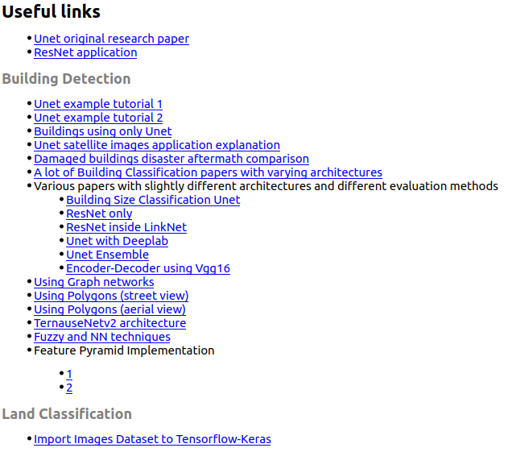
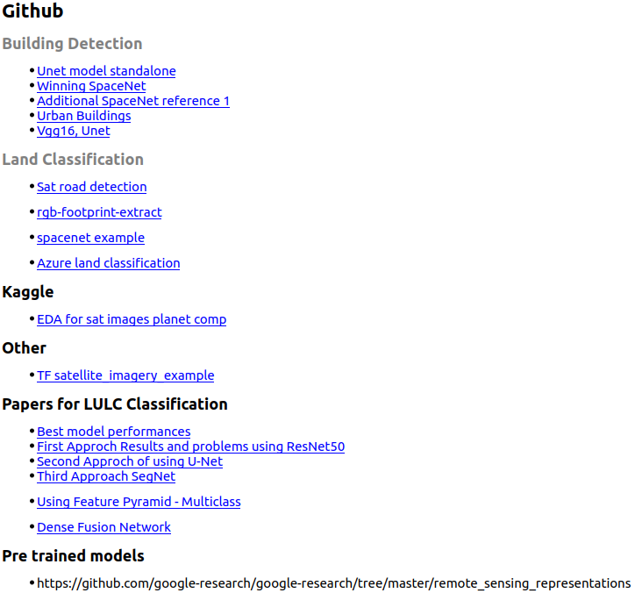

Slide 12
